Slide 1
Physical computing from Scratch using scratchClient – Beginners
Control servos, LEDs and more from Scratch using RPi, Arduino, scratchClient
Hans de Jong & Gerhard Hepp
Pi And More 10
Trier – 24 June 2017

Slide 2
Part 1: Introduction
2

Slide 3
If the presentation is messed up …
You need the Calibri font on your Raspberry Pi (standard on Windows but not on Raspberry Pi).
Either obtain and install that font, or …
… look at the PDF version of the presentation
  But in that version you cannot copy/paste.
  Therefore there is a file called ForCopyPaste.txt in the directory holding whatever you would need to copy paste in this workshop.
3

Slide 4
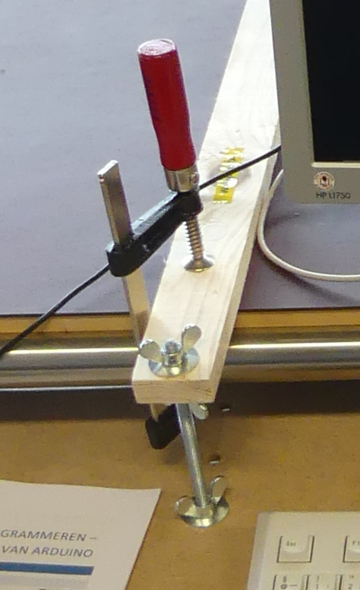
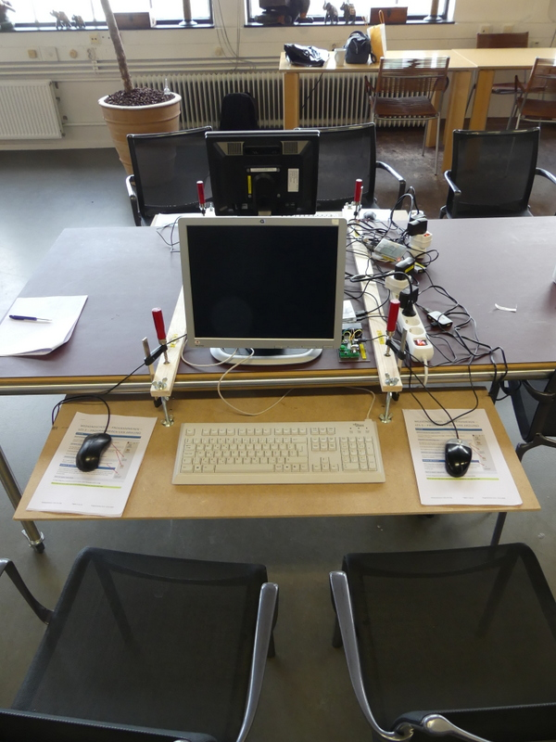
Ergonomics
At the Weekendschool we teach children 5 golden rules how to sit when using computers:
  Rest your arms on the table in a natural fashion.
  If you do not need the keyboard, move it up and give room to the mouse.
  Have the monitor at arms length.
  Change position (lean forward, backward etc.).
  Frequently stop, walk around and exercise.
To change the height, use the two upper wingnuts.
4

Slide 5
Workshop organisation
The major steps:
  Get a working hardware and scratchClient config using a scratchClient config tool (new).
  Put components on the board and test out your setup.
  Write some code in Scratch
  Add more hardware and update the config file.
  And repeat this.
  When time left: write a Scratch program.
Welcome and introduction presentation (10 min).
After that everyone will work at his or her own pace.
At times we will present for 5 minutes to explain a next concept.
Language: English, but help in German is available.
At the end copy the material you created to your USB stick (if you want)
Cleanup, or prepare for the Advanced workshop.
5

Slide 6
Objectives
At the end of today you should be able to:
  Reproduce the setup at home (provided you have the hardware ☺ )
  Understand
    Digital output (e.g. lighting a LED)
    Digital input (e.g. sensing a button)
    Analog input (e.g. from a potentiometer)
    Pulse Width Modulation (PWM)
      For dimming LEDs
      For controlling servos
      For sounding a buzzer
  Understand what all the resistors are for
  Be able to configure and run scratchClient
  Program Scratch to control the physical input and output
  Monitoring the inputs and outputs
Have fun!
6

Slide 7
Non-objective
It is not an objective to create a complete useful game or other program.
  You can do that with your own creativity at home now that you know how to control several pieces of hardware from Scratch using scratchClient.
7

Slide 8

Weekendschool
Generally parents tell their children: “Learn for later”. But what is later?
“I want to become an engineer. Do you maybe know an engineer? I would very much like to meet one”
Professionals teach children on Sundays about their job. Large variety of topics.
> 1000 students between 11 and 14 years from underprivileged areas.
Curriculum lasts for 2.5 to 3 years
3500+ volunteers.
Funded by 110+ sponsors (companies, individuals, foundations).
Started in 1998.
It works! Data shows: alumni have better professional prospects, are more self-aware, and feel more connected with society.
EINDHOVEN
58 students
IMC Weekendschool
Trudo Weekendschool
8

Slide 9
Lessons at the Weekendschool
I personally teach
  Mathematics (since 2004)
  Physics (since 2011)
  Programming (started in 2016)
  Electro (started in 2016)
Programming: 3 (2) lessons on 5 (3) Sundays with Scratch, Raspberry Pi and Arduino
  Last lesson comprises 2 days but is optional and can be done in a later year.
Lesson 2: Physical computing: https://www.youtube.com/watch?v=Qo1gnXNzhqE
9
Notes:
9

Slide 10
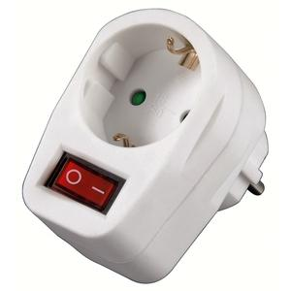
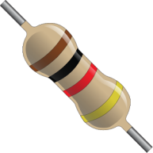
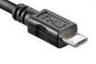


Only a few rules today
If Raspberry Pi needs to be rebooted, it needs a powercycle. Please do not pull plugs but use the switch in the outlet after you have done the shutdown.
Always put a resistor in series with the components when indicated.
  If you think there is no need then please tell us and we will explain
  what the reason is.
When changing the wiring
  Detach the USB cable from the Arduino Nano
  Switch off the 9V power
  Check, double check and check again whether the wiring is correct.
  You may blow up components when wiring wrongly!
  Make sure that you both (4 eyes principle) are convinced the wiring is OK
  before turning on power again.
  After changing a config file: restart scratchClient
If something breaks down or gets damaged: we have some spare material
  Do not put anything that is broken back into the box please.
10

Slide 11
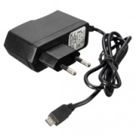
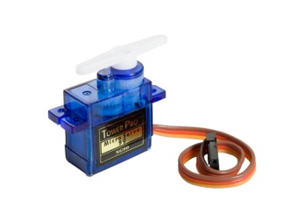
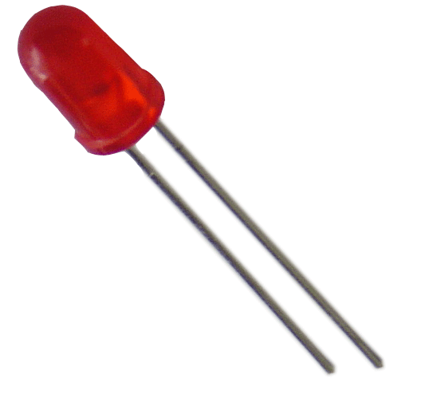
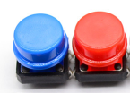



The setup
Raspberry Pi
2B or 3B
Powered USB hub
(Not used when programming the Arduino Nano)
(not strictly needed since Arduino is powered separately – used for protection of RPi)
Arduino Nano
Scratch 1.4 run time
scratchClient
scratchClient Sketch
Remote Sensor Protocol Over socket 42001
Global variables
Broadcasts
Program in Scratch
Predefined sprites (with some code, sounds and costumes)
scratchClient Config file
Defines function of the GPIO pins on the Arduino (and RPi) and gives them logical names.
Standard setup
Programmed by the students
Prepared by the teacher or expert
11

Slide 12
Where is the presentation?
You will find this presentation = the instruction at your desktop in the folder PiAndMore.
If you already know the stuff in the presentation and get bored then feel free to work on your own
  Silently please … ☺
12

Slide 13
Part 2: Getting to know the components
13

Slide 14
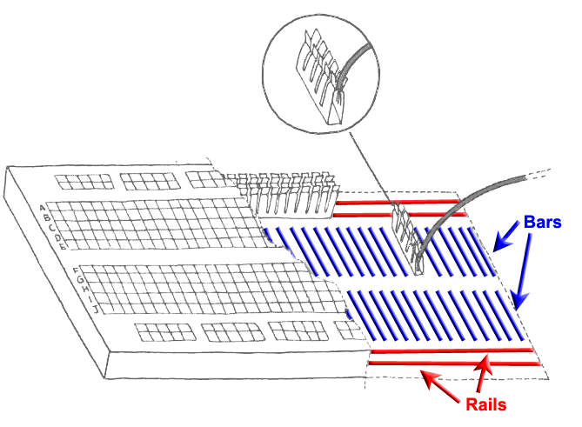
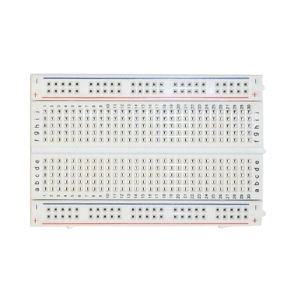
Breadboard
Used to quickly build electronic circuits
Note the 2 rails for + (VCC) and – (GND)
Note the 2 bars with 5 interconnected holes each.
14

Slide 15
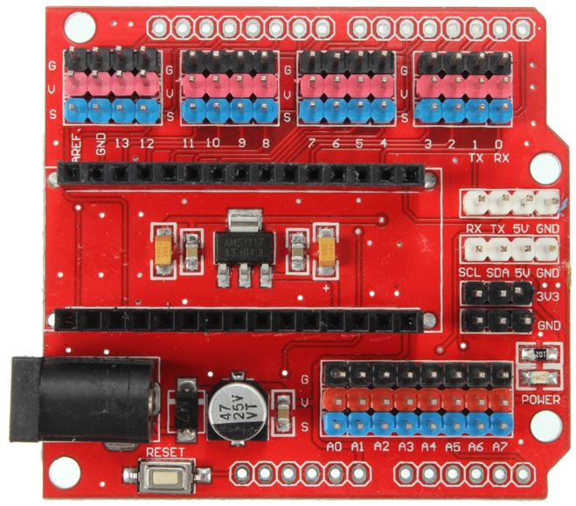
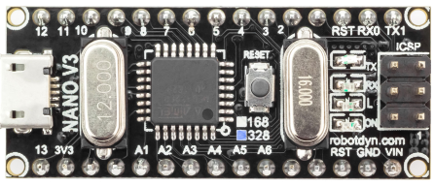
Looking at the Arduino Nano extension board
Analog ports (most can be used as digital ports as well)
Reset button
Per GPIO signal 3 headers:
S (blue = signal)
V (red = VCC = +)
G (black = GND = -)
(very handy to e.g.
connect servos)
9V power socket
Arduino Nano with 328P processor
Micro USB port
Reset button
Digital ports
15

Slide 16
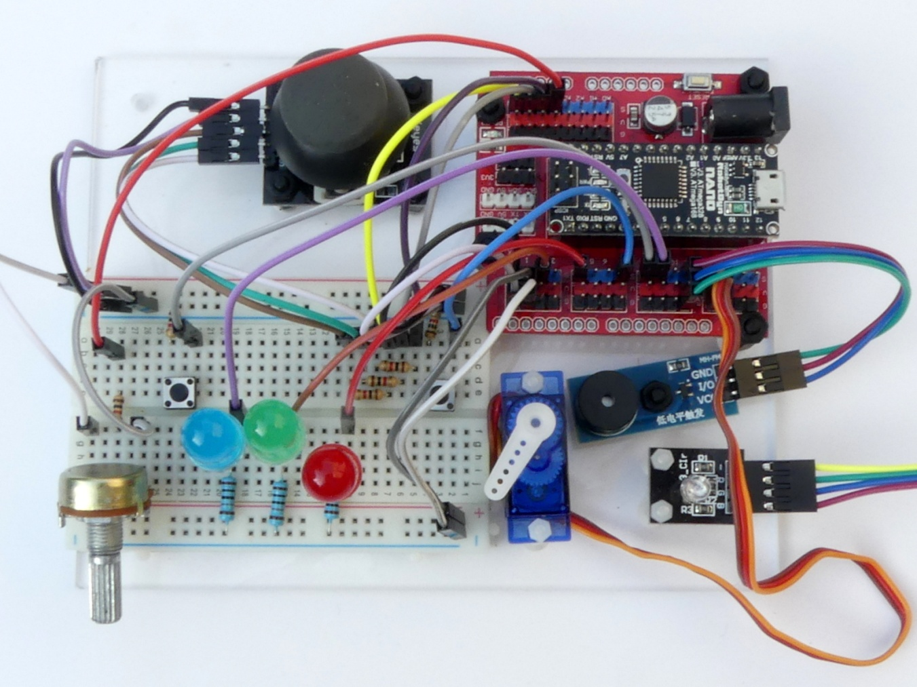
What the final board looks like …
… at the end of the beginners workshop
16

Slide 17
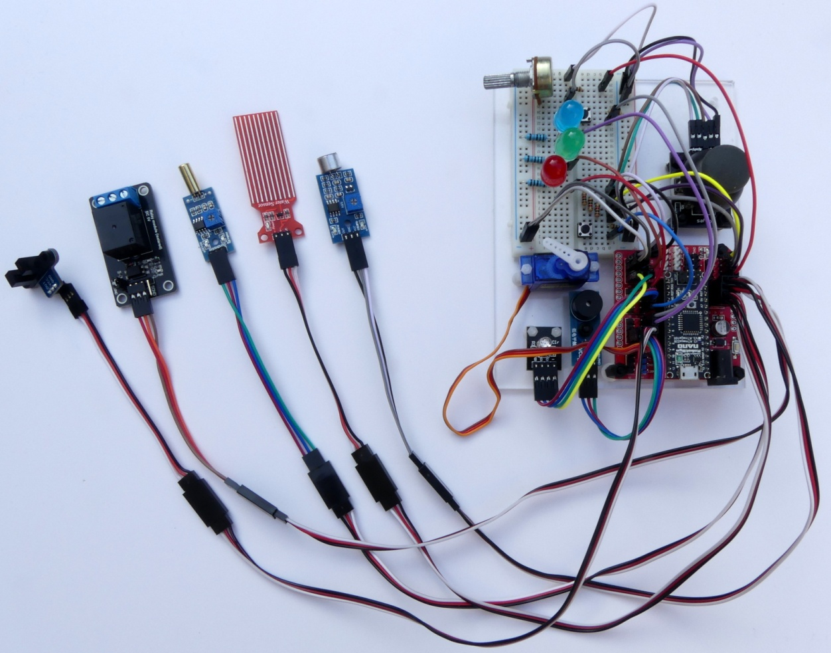
… and if you continue with the advanced workshop
17

Slide 18
Part 3: Loading the sketch in the Arduino
18

Slide 19
Preparing for programming the Arduino Nano
The Arduino needs to run a program so that it can communicate with the Raspberry Pi and understand the messages from scratchClient.
  We need to start putting that in.
Connect the Arduino Nano
  Make sure to connect directly
    not via the USB hub
    for strange reasons it will not work via a (this) USB hub, although it used to in previous releases of Raspian (and still should).
19

Slide 20
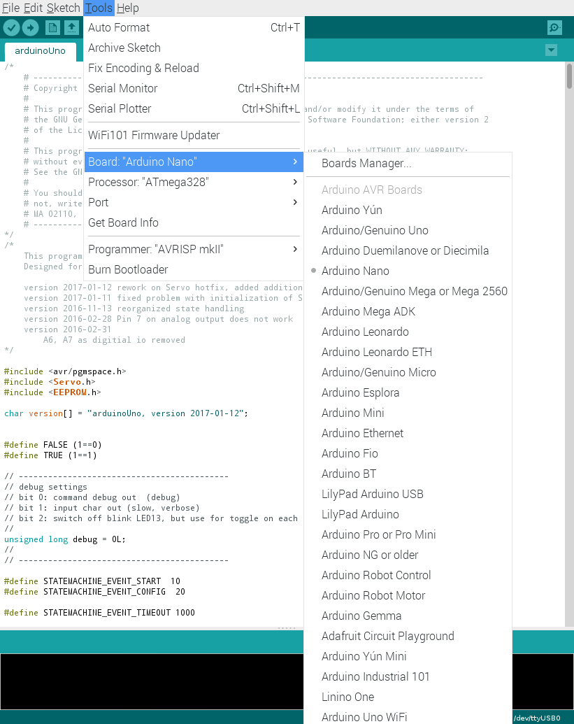
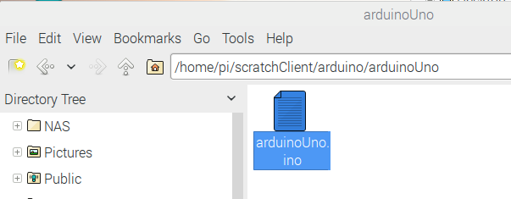
Uploading scratchClient to the Arduino
Make sure that the Arduino is directly connected to the Raspberry Pi (not via the USB hub)
Open the scratchClient sketch for Arduino Uno in /home/pi/scratchClient/arduino/arduinoUno
Double click to open the Arduino IDE
Click Tools and make sure that these are set:
  Board: Aruino Nano
  Processor Atmega328
  Port: the port where the Arduino Nano is connected (normally /dev/ttyUSB0)
Click on the Upload button.
Wait till the completion of the Upload is reported.
20

Slide 21
Part 4: Defining the configuration
Give names to pins and define the purpose of the pin
21

Slide 22
Starting the config tool
This creates config files to map between Arduino pins and logical names.
Navigate to /home/pi/scratchClient/tools
Doubleclick scratchClientConfig.sh and chose Execute.
  If the file opens rather than presenting the choice, then you must set execute permissions first.
  To set permissions: right click on the icon, choose properties, then permissions and set execute rights to at least owner.
22

Slide 23
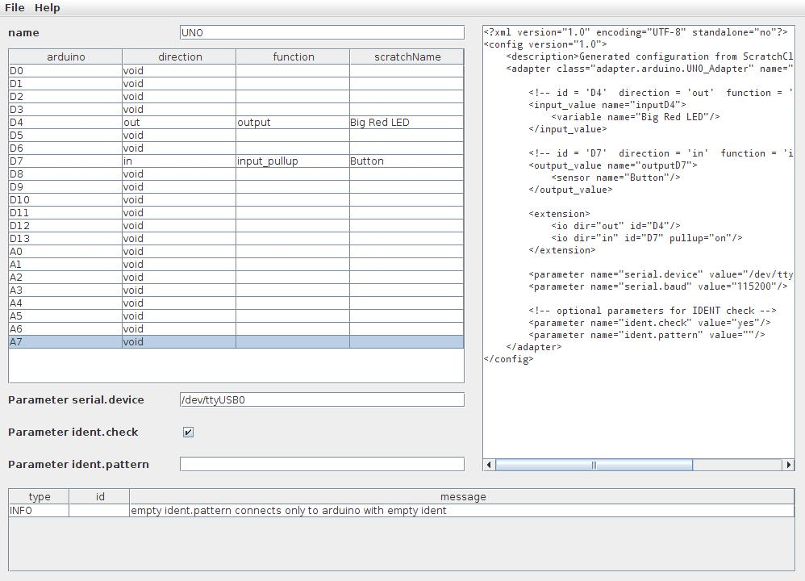
Define the first config file
Double click a cell to get a drop down menu
  First for direction then for function.
Make sure to give all pins a name if you choose something else than void
  So make sure not to save if you still have red borders around cells. scratchClient will fail to start with such a config file.
The tool checks wrong configurations. Examples:
  Pins 0, 1 and 13 cannot be used at all
  Analog in only available on A0 to A7
  Pins A6 and A7 can only be used for analog in
  Pins 9 and 10 cannot be used for PWM if any pin is configured for servo (see later)
23

Slide 24
Save the config file
Save the file in the folder PiAndMore on the desktop
Call it PiAndMore.xml
Leave the tool open for the next exercises.
24

Slide 25
Part 5: Wiring the board and run the first setup
25

Slide 26
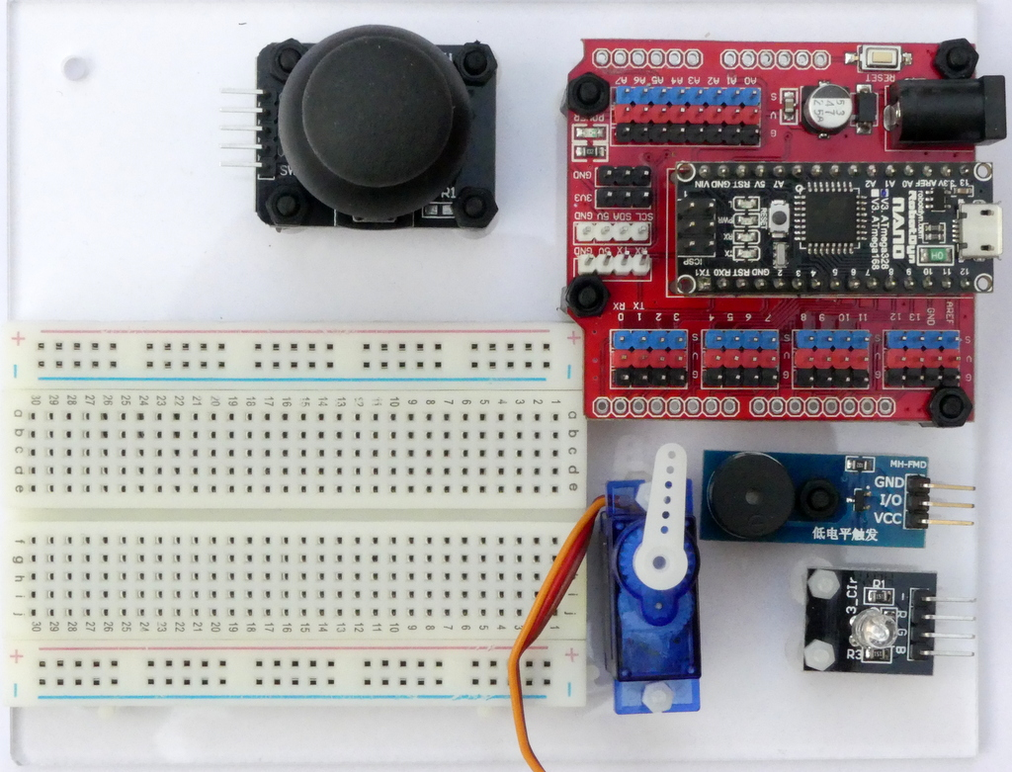
Put the board in front of you in this way
26

Slide 27
Use short wires and use the indicated holes
There are some short wires (10 cm) and some longer (15 cm)
Use the shortest that you can
  Get a less messy setup
  You may run out of long wires otherwise
Ignore wire colors.
  Unfortunately there are not enough wires of the correct color to get that right.
You can in principle build up at different places on the breadboard
  However, please use the indicated columns to avoid running out of space on the breadboard in the later part of the workshop.
27

Slide 28
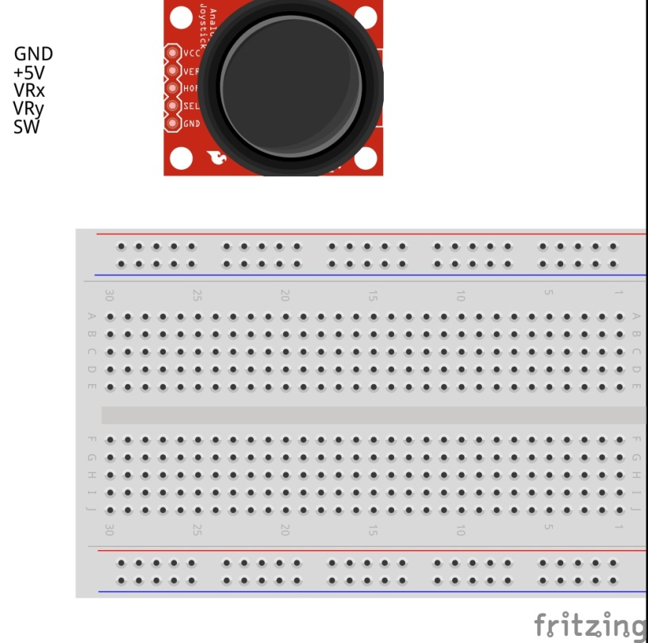
Connect the power wires
28

Slide 29
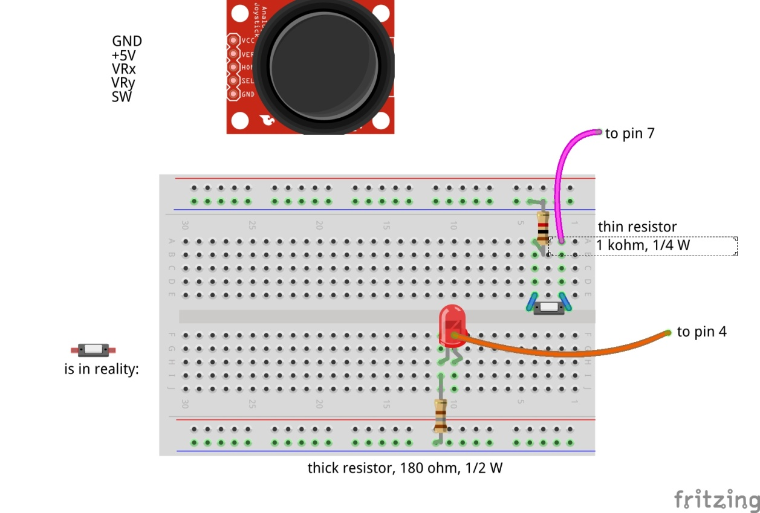

Insert the red LED and button
29

Slide 30
Why are these resistors needed?
In series with a LED: to limit the current through the LED
  You may blow up the LED and/or the Arduino otherwise.
In series with buttons, potentiometers etc: to avoid blowing up the Arduino in case of config errors
+5 Volt
Consider what would happen if the 1 kOhm resistor were not present and the port would be used as output and the button closed.
Then the Arduino would output 5 Volt, and the switch is directly leading it to the 0 Volt line → short circuit!
Arduino
This is a pull-up resistor that sits in the chip on the Arduino Nano
Digital input
30 kOhm
1 kOhm
0 Volt
30

Slide 31
Check / double check
Please now check both of you that the wiring is correct.
31

Slide 32
Make a script file to start scratchClient
Then make a new file in the PiAndMore folder on the Desktop
  Call it StartSC.bash
Put this into the file (copy/paste from this presentation):
  !# /bin/bash
  sudo python ~/scratchClient/src/scratchClient.py -c ~/Desktop/PiAndMore/PiAndMore.xml
  pause –p “Press Enter to continue”
Make the file executable (file properties, permissions)
Do you understand what the file does?
  If not, please ask
32

Slide 33
Bringing things together
Connect the 9 Volt connector to the board and switch on power
Connect the USB connector to the Arduino, this time go via the USB hub
Start scratchClient with the script you just made (e.g. double click it and when asked choose Execute in Terminal).
It will complain that it has no connection to Scratch
  Which is logical because Scratch was not started yet.
33

Slide 34


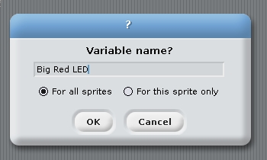

Create the Scratch program
Start Scratch → Programming → Scratch
Enable remote connections (right click on sensor value)
Create the variable Big Red LED, available to all sprites
Make the variable visible (tick the box in front)
Make the Button sensor visible
Save the file in the PiAndMore folder on the desktop
  Name does not matter, e.g. PiAndMore.sb
34

Slide 35
Does it work? (see next slide for help)
If the LED on the Arduino is blinking slowly only then the config is downloaded and scratchClient works.
It may take 5 seconds before this happens.
Change the value of Big Red LED to 1.
  You can use the slider on the variable. You see no slider? Double click it a few times.
  Does the LED lite?
Press the button on the breadboard
  Do you see the value of the sensor Button change from 1 to 0?
35

Slide 36
What if it does not work?
Check whether you have multiple Scratch instances open
  scratchClient can only work with one Scratch at a time.
Check the output of the scratchClient terminal window
  Did it find the board?
Sometimes, especially after reboot, if everything seems fine, disconnecting and reconnecting the board may help.
Try monitoring the variables (see next slide).
If everything fails, scratchClient can be started with tracing on.
But of course we are here to help you at any step.
36

Slide 37
Monitor the variables
Open the browser
Type localhost:8080
Click adapters
Note the input & output directions:
  Output of an adapter is an input for scratch
  Output of scratch is an input for the adapters.
  Hence the names input and output look to be reversed from what is in the config file.
  Therefore best refer to the variable names.
You will see that values are only displayed after they have changed (otherwise a question mark (?) is displayed).
37

Slide 38
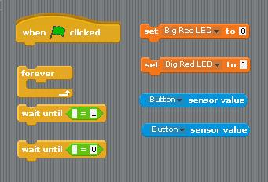
Program in Scratch
Make a program in scratch which will let the Red LED lite up when the button is pressed.
You need these elements.
38

Slide 39
One reminder …
Save your Scratch program regularly. Otherwise it will be lost on power out
  Power out can easily happen since you are pulling cables and may impact the power connector in the Raspberry Pi.
Every now and then copy the Scratch file to a backup file
  Recommendation: give those copies a sequence number.
39

Slide 40
Part 6: Adding the Big Green LED
40

Slide 41
Changing the wiring on the board
When changing the wiring on the board
  First pull the USB cable out (from the board or from the hub)
  Switch off the 9V supply
41

Slide 42

Adding the green LED
42

Slide 43
Check and reconnect
Check the correct wiring
Switch on the 9V power
Connect the USB cable again
43

Slide 44
Update the config file and restart scratchClient
Stop scratchClient (close the window)
Use the config tool (which should still be open)
Define an output (direction: out, function: output) on pin 2 and call it Big Green LED
Save the config file (and leave the tool open)
Restart scratchClient using the script that you created before
44
Notes:
44

Slide 45
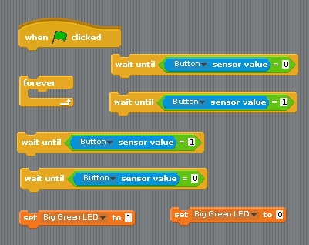
Update Scratch
Define the variable Big Green LED
Create a sprite for the green LED
Create in that sprite a program that implements a toggle switch:
  Press once: LED goes on
  Press once more: LED goes off
You need these program elements.
45

Slide 46
Part 7: Adding analog input
46

Slide 47
The electronics of a potentiometer
The potmeter is a resistor that will be connected between 5 V and 0 V.
Over the length of the resistor the voltage drops linearly.
  E.g. in the middle it would be 2.5 Volt
  So this is an analog signal. The value can be changed between 5 V and 0 V.
There is a 1 kOhm resistor in series for the reasons discussed earlier
+5 Volt
Consider what would happen if the 1 kOhm resistor were not there and the port would be used as output and potmeter positioned close to the 0 Volt side.
Then the Arduino would output 5 Volt, and the potmeter is directly leading it to the 0 Volt line → short circuit!
Arduino
1 kOhm
Potentiometer
Analog input
10 kOhm
Resistor
0 Volt
47

Slide 48
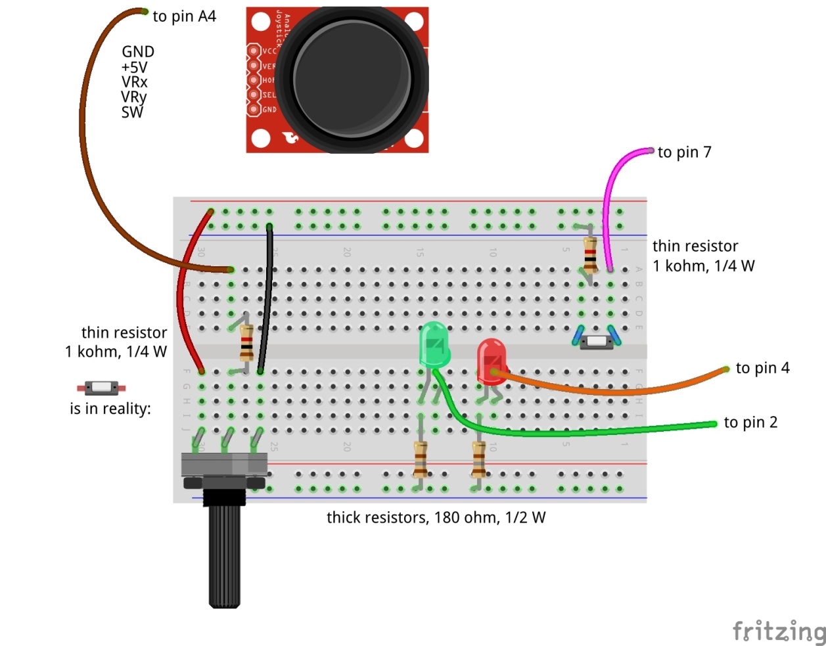
Adding analog input
Don’t forget: power off and USB cable out before making changes!
48

Slide 49
Update the config file
Update the config file again
  Define Potmeter on pin A4 (direction: in, function: analog)
Now that you are updating anyway, already define for the next steps:
  Define Servo 1 on pin 12 (direction: out, function: servo)
  Define Big Blue LED on pin 5 (direction: out, function: PWM)
  Define Buzzer on pin 11 (direction: out, function: PWM)
Don’t forget to save
49

Slide 50
Test whether it works
Stop and restart scratchClient
Reconnect and repower the board
Make the sensor Potmeter visible
Turn the knob and see the values of Potmeter change
  Between about 0 and about 1024
We will write some Scratch program to use it in the next step
50

Slide 51
Part 8: Pulse Width Modulation
51

Slide 52
Where we are …
We have seen:
  Digital Input (the button)
  Digital Output (the LEDs)
  Analog Input (the potentiometer)
So what would be most logical next?
  Analog Output? → but it does not exist!
  However there is a good alternative: Pulse Width Modulation
52

Slide 53

Pulse Width Modulation (PWM)
By modulating (changing) the pulse width, the amount of energy fed to the e.g. LED is changed, and hence the intensity with which you see it lighting.
Note that in practice the LED is blinking some 800 blinks / second.
However, no human eye can see more than 100 blinks / second.
53

Slide 54
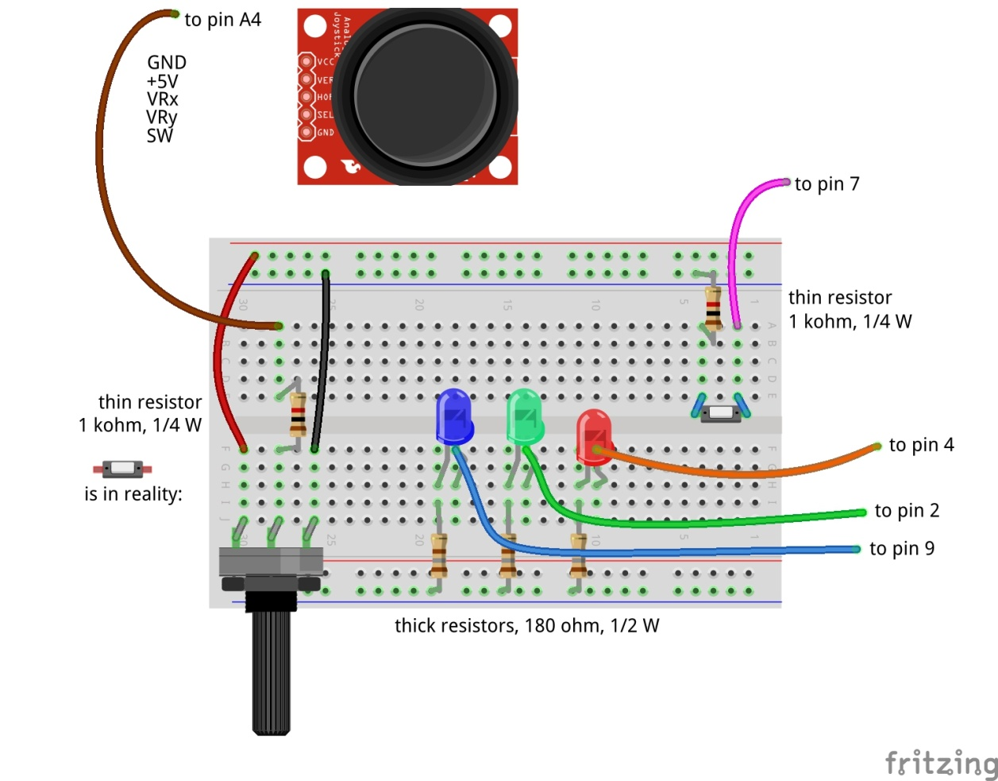
Dimming a LED with PWM
Don’t forget: power off and USB cable out before making changes!
54

Slide 55
Test
Switch the power on again and reconnect
You will see that scratchClient finds the board again
You already updated the config file in the previous step, so no need to restart scratchClient
Define in Scratch a variable Big Blue LED
Make the variable visible
Give Big Blue LED values between 0 and 255
  You can use the slider on the displayed variable for values between 0 and 100
  For values above 100 we will use a program, see next slide
Does the LED brightness change?
55

Slide 56
Connect Potmeter and Big Blue LED (via Scratch)
Make some code that takes the potentiometer reading (between 0 and 1024) and transforms it into the range 0 to 255 (so divide by 4) and set the value of Big Blue LED.
Try out whether turning the potmeter changes the light intensity.
Notice that when turning to the right, the intensity goes down.
  You would expect it to go up …
  How can you very simply change this by interchanging two wires?
56

Slide 57
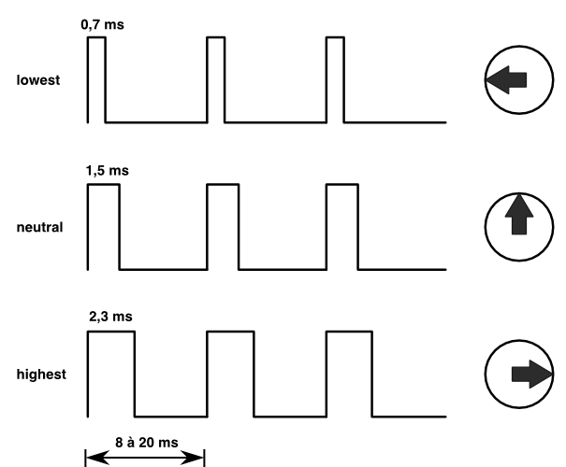
Controlling a servo with PWM
The position of the servo is changed by sending pulses of different width.
The servo looks at the pulsewidth and turns as desired.
The servo gets power separately.
With a servo, the pulse width modulation is not controlling the amount of energy fed to the servo
With a servo, pulse width modulation is rather a communication protocol.
57

Slide 58
Adding the servo to pin 12
Dark brown wire here
Don’t forget: power off and USB cable out before making changes!
58

Slide 59
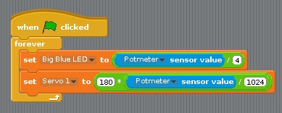
Testing the servo
Reconnect and repower the board
In Scratch, create a variable Servo 1 and make it visible.
Try out giving it values between 0 and 100 via the slider on the variable.
  The servo can handle values between 0 and 180
  Does it move?
Update the loop where you set the Big Blue LED value
dependent on the potmeter reading to now also set Servo 1.
  But watch out: values have to be between 0 and 180.
  To avoid overflow: first divide by 1024, then multiply by 180.
You may observe jitter.
  Because the values of the potmeter will drift a bit and there will be power fluctuations, the reading of the potmeter will not be constant.
  We will in the advanced workshop show how to deal with jitter
59

Slide 60
Controlling a buzzer with PWM
The buzzer will sound if it gets a signal in an audible frequency range.
A PWM signal on Arduino gives ca. 800 Hz.
  Different for different pins
You will see that there is not much influence by changing the duty cycle.
60

Slide 61
Connect the buzzer to pin 11
Carefully watch the wires. Connect Vcc, GND and I/O correctly!
Don’t forget: power off and USB cable out before updating!
61

Slide 62
Testing the buzzer
No need to restart scratchClient, because the config file was not changed.
Define a variable Buzzer in Scratch
Give it values between 0 and 100
  Using the slider on the variable
  Does the value have much impact?
Add the setting of the buzzer to the loop where you already set the servo and the Big Blue LED.
  Like with the LED, the values must be between 0 and 255.
Only test a short time (to save the ears of your neighbors ☺).
62

Slide 63
PWM limitations of Arduino (Nano and Uno)
General PWM is available on pins 3, 5, 6, 9, 10, 11
Servo can be configured on those pins, but also on 2, 4, 7, 8, 12
If a servo is configured on any pin, pins 9 and 10 cannot be configured as PWM anymore.
  The config tool will warn you if you do it wrongly.
63

Slide 64
Part 9: Make a Scratch program
Extra material in case you have time left
64

Slide 65
Integrate with sprites
Load the following sprite
  Big Red LED
  Sits in the PiAndMore folder on the desktop in a folder Sprites.
Take a look at the code of the sprite.
Update the code that you wrote earlier today for the Big Red LED so that it sends messages to the sprite to turn the LED on and off
65

Slide 66
Add the Big Green LED sprite
Same that you did with the Big Red LED sprite, but now for the Big Green LED sprite.
66

Slide 67
Add the Big Blue LED sprite
Load the Big Blue LED sprite
Analyse the code in that sprite, which is different
  The Big Blue LED sprite will move over the screen as the intensity changes
  You can also move it with your mouse and see the intensity change.
Update your code that you wrote earlier to make use of the sprite.
67

Slide 68
Part 10: Take your work home
68

Slide 69
Do you want to take your work home?
If you brought your own USB stick, then connect it and copy the PiAndMore folder on the desktop
The rest of the material you can download from www.github.com
Take the flyer with you to remember where to find the material on github.
69

Slide 70
Part 11: Summary & take aways
70

Slide 71
Take aways of the beginners workshop
With scratchClient you define:
  Function of each pin
  Symbolic name for each configured pin
scratchClient config is the tool to setup the configuration
Restart scratchClient after you changed the configuration
Put a resistor in series with LEDs
Put a resistor in series with switches
Put a resistor in series with the middle contact of a potentiometer.
Configure a pull up resistor if the input signal goes between 0 Volt and being open rather than between 0 Volt and 3 to 5 Volt.
Output signals are controlled from Scratch by giving a variable a value
Input signals are monitored by the sensor programming elements
You can monitor the value of all pins from the browser
scratchClient can do much more…
Functions that a pin on Arduino can have:
  Digital In
  Digital Out
  Analog In
  No Analog Out
  Pulse Width Modulation as alternative
    For modulating the brightness of a LED
    For controlling a servo
    For controlling a buzzer
  There a few more, see the advanced workshop
  You can configure pull up resistors on Digital In
71

Slide 72
If you want to know more …
Join the advanced workshop
Download the material and read the extensive documentation
72

Slide 73
Part 12: Clean up / teardown
73

Slide 74
If you continue to the Advanced Workshop …
You can continue to use your setup, with one exception:
You need to move the Big Blue LED to pin 9
  Direction: out, function: output (so no PWM)
In the mean time you should know how to do this, otherwise please ask.
74

Slide 75
If your scratchClient day ends here …
Unplug the board from USB and power off the device
Please remove all components and wires from the breadboard
Remove all wires from the Arduino board.
Leave the wires on the 3 color LED (you did not use that)
Leave the wires on the buzzer
If something is broken, please
  Throw it away or hand it in (if it is unclear)
  Put a note in the box that it is missing
  Do not put anything that is broken back in the box
Leave the Arduino running
Let us know what you thought about this workshop, now orally or later by email
  hans.piam@hanselma.nl
  heppg@web.de
75

Slide 76
More information
All workshop material
  www.github.com and search for Weekendschool or for PiAndMore
scratchClient
  http://heppg.de/ikg/wordpress/?page_id=6
Scratch
  https://scratch.mit.edu/
Scratch on Raspberry Pi
  https://www.raspberrypi.org/forums/viewforum.php?f=77
Raspberry Pi
  https://www.raspberrypi.org/
Arduino
  https://www.arduino.cc/
76

Slide 77
End of the beginners workshop
77

Slide 78
Physical computing from Scratch using scratchClient – Advanced
Control servos, LEDs and more from Scratch using RPi, Arduino, scratchClient
Hans de Jong & Gerhard Hepp
Pi And More 10
Trier – 24 June 2017

Slide 79
Before we start
79

Slide 80
If you do not roll over from the beginners workshop …
If you are familiar with scratchClient, but not with the new config tool …
  … you may want to look at some slides of the beginners workshop
Other than that, you do not have to build up the complete setup what the people of the beginners workshop did.
  Only those things on the next slide.
You will however see the components of the beginners workshop in the diagrams.
  Just ignore those.
80

Slide 81
Make a script file to start scratchClient
Then make a new file in the PiAndMore folder on the Desktop
  Call it StartSC.bash
Put this into the file (copy/paste from this presentation):
  !# /bin/bash
  sudo python ~/scratchClient/src/scratchClient.py -c ~/Desktop/PiAndMore/PiAndMore.xml
  pause –p “Press Enter to continue”
Make the file executable (file properties, permissions)
Do you understand what the file does?
  If not, please ask
Only to be done if you did NOT continue from the beginners workshop
81

Slide 82
Connect the power wires
Only to be done if you did NOT continue from the beginners workshop
82

Slide 83
Make the config file for all steps
In order not to loose time, it is recommended to add all setups in the config file now.
  If you continued from the beginners workshop then leave in what you have, only add.
  D3: out, pwm, 3Color Red LED
  D5: out, pwm, 3Color Blue LED
  D6: out, pwm, 3Color Green LED
  D8: in, counter_pullup, Counter button
  D10: in, counter, IR sensor
- A0: in, analog, Rain Sensor
- A1: in, input_pullup, Tilt Sensor
- A2: out, output, Relay
- A3: in, analog, Sound Sensor
- A5: in, input_pullup, Joystick Button
- A6: in, analog, JoyStickY
- A7: in, analog, JoyStickX
83

Slide 84
Make variables
Save the config file
(Re)start scratchClient
In Scratch, create a variable for each of the out parameters.
  Note: variable names are case sensitive.
In Scratch, make all of the sensors visible, so all in parameters.
  Will only work if scratchClient successfully communicates to the board.
84

Slide 85
Choose the topics you want to give priority
The advanced workshop may be too short to do all activities.
  So pick the order of the topics from the list
The red topics teach you more about scratchClient.
The green topics teach you more about electronics, sensors and engineering.
If you rather would do pieces of the beginners workshop then that is fine as well.
Joystick
  Control position or control speed
  Take care of calibration and drift
3-color LED
  To make any color
Counter function
  With button or IR slotted sensor
Rain sensor
Tilt sensor
Sound sensor
Strongly link the config file to the Arduino
  For safety
  For connection errors
Control multiple Arduinos concurrently
Power On Self Test
Controlling a relay
Controlling 220 Volt appliances (only info)
Controlling a camera (only info)
85

Slide 86
Joy stick
86

Slide 87
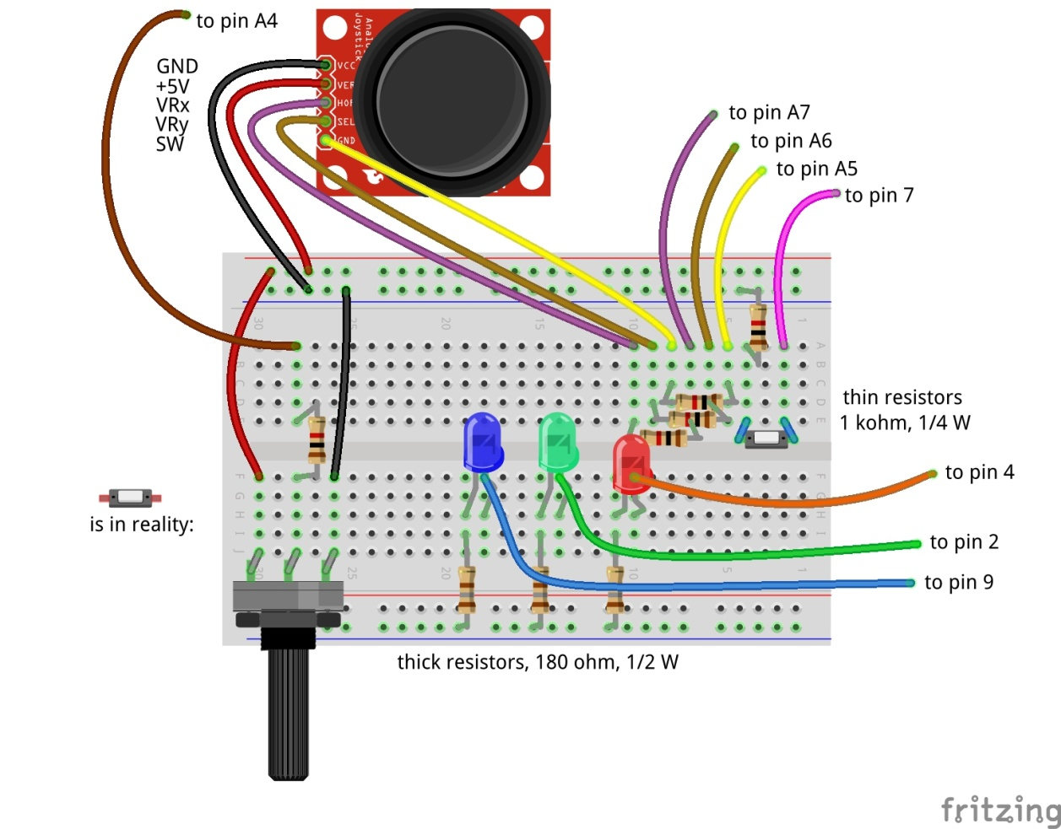
Adding the joy stick
X
Y
Don’t forget: power off and USB cable out before making changes!
87

Slide 88
Try it out
A joy stick has two small potentiometers and a button
  When the joy stick is released (neutral position), the potentiometers are in the middle of the value range (middle between 0 and 1024)
  There is one potentiometer for X and one for Y
  The button is operated when pressing the button.
Reconnect and repower
Wait till the Arduino LED blinks slowly.
Now try moving and pressing the joy stick. Look at the 3 joy stick values to change
  JoystickX and JoystickY between about 0 and about 1024.
  Joystick Button between 0 and 1
88

Slide 89
Uses of Joysticks
You can directly use the value of the joystick
  E.g. to control the position of a servo
  E.g. to control the intensity of a LED
  When releasing the knob, it will move back to the middle value.
  E.g.: LED = JoystickX
You can alternatively use the joystick to determine the speed of the change
  E.g. move a servo fast or slow. Let the servo stop at the latest position when you release the knob.
    E.g.: LED = LED + (JoystickX – 512) / 200 (512 = neutral position value, 200 = sensitivity)
  You can also use the Scratch pen function draw on the screen.
    And e.g. use the potentiometer to change pen width or color.
Take care of drift and jitter (see next slide)
89

Slide 90
Take care of drift and jitter
Not all joysticks will give the same value if they are in the middle position
Influenced by temperature, the value produced in the middle position can drift over time.
Therefore build in some threshold around the middle position
  If the middle position is 512, then do only react if the value changes by at least ca. 15, so e.g. > 525 or < 500.
  Whether 15 is enough as threshold you will learn over time. Increase the value if it drifts more than that.
  If you have a general program that works with several joysticks then you may have to use a larger threshold, or you need to calibrate (adapt the program for each particular servo).
90

Slide 91
Control a 3-color LED
To make all colors
91

Slide 92
Control a 3-color LED
Don’t forget: power off and USB cable out before making changes!
A 3-color LED has 3 LEDs in one package
  Green
  Red
  Blue
Use PWM to change the intensity of each color
  In that way you can create the entire spectrum of light
  Including white light
Connect the 3-color LED carefully to the pins as defined in the config file.
Also connect the minus (–) pin to GND
Reconnect and repower
No need to restart scratchClient (since no update to the config file was made)
Give the corresponding variables in Scratch values between 0 and 100 with the slider on the variable.
  Does it work?
We will see in the next slide how to use values between 0 and 255
92

Slide 93
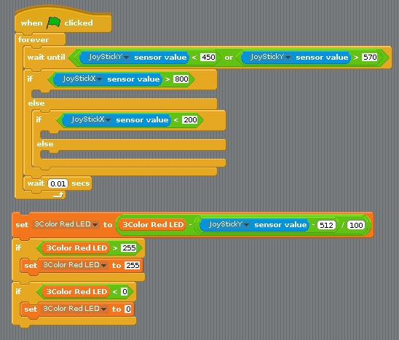
Connecting the 3-color LED to the joy stick (via Scratch)
Write a program in Scratch that:
  Uses the value of the X direction of the joy stick to determine red, green or blue
  Uses the value of the Y direction to change the intensity of the respective LED
  When releasing the joy stick, the colors should stay
  You will need these elements
You need this block 3 times for the 3 colors
93

Slide 94
The new counting function
94

Slide 95
Why a special counting function?
You can count in Scratch, however you can only reliably count a few pulses per second.
With this new counting function, you can do it much faster
If you need to detect small pulses that scratchClient may not see reliable, you can use a counter function to detect whether a (short) pulse did arrive.
95

Slide 96
Counter function using a button
It will count up. It will wrap round at a very large value that will be reached after days of counting.
Max. ca. 80 counts per second = 4800 per minute
There is a 4 ms debouncing delay
  So multiple pulses within 4 ms will processed as a single count
  So no need for capacitors to do debouncing
96

Slide 97
Debouncing
If a mechanical switch is operated, it can generate a series of pulses rather than one.
This is because one of the metal pieces bounces back a few times before it stays in position.
You would normally need take care of this if you want to get a single pulse
  E.g. add a capacitor.
scratchClient will on the digital input pins only sample with 10 Hz, so it is unlikely that you will experience bounce problems.
97

Slide 98
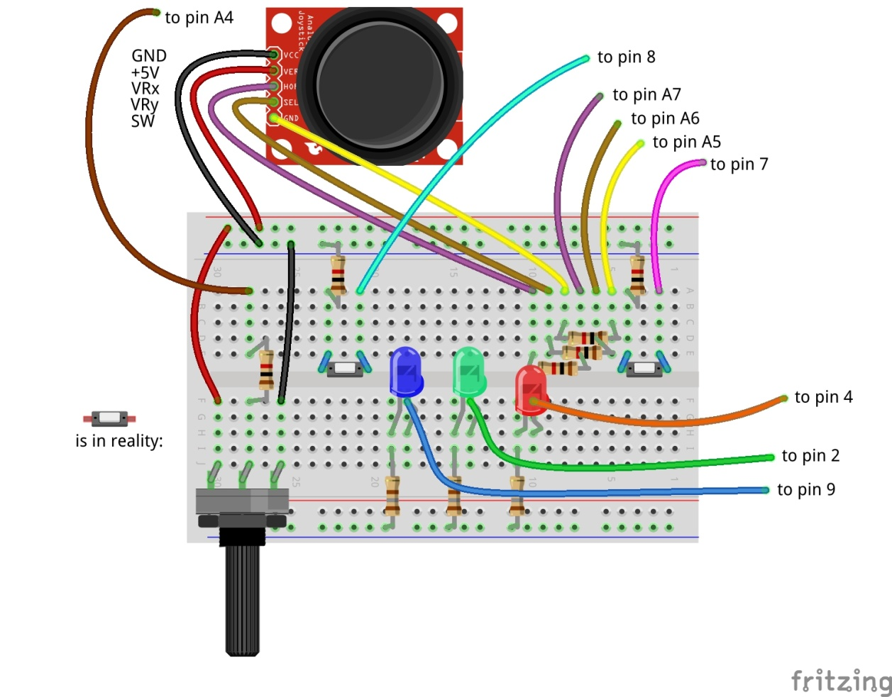
Adding the count button
Don’t forget: power off and USB cable out before making changes!
98

Slide 99
Adding an IR speed sensor that counts on pin 10
Carefully follow the wires to connect correctly!
Don’t forget: power off and USB cable out before making changes!
99

Slide 100
Differences between the counters
The IR sensor gives an output of 0 Volt or 5 Volt.
  Therefore it does not need a pull up resistor (see the config file)
The button gives an output of 0 Volt or open.
  Hence it needs a pull up resistor (as specified in the config file)
100

Slide 101
Try out the setup
The button you can just press.
The IR sensor you need to have good opaque material to let it work.
  You can check the sensing by the LED at the backside.
101

Slide 102
Tilt sensor
102

Slide 103
Tilt sensor
The tilt sensor is a sensor containing a rolling ball between contacts.
  You can hear it rattling if you shake it.
It is not in the box. We only have a few, so you will need to share.
103

Slide 104
Connect the tilt sensor to pin A1
Carefully follow the wires to connect correctly!
Don’t forget: power off and USB cable out before making changes!
104

Slide 105
Rain Sensor
105

Slide 106
Rain sensor
A rain sensor is an analog sensor that measures conductivity that is influenced by water.
It is not in the box. We only have a few, so you will need to share.
106

Slide 107
Connect the rain sensor to pin A0
Carefully follow the wires to connect correctly!
Don’t forget: power off and USB cable out before making changes!
107

Slide 108
Sound sensor
108

Slide 109
Sound Sensor
The sound sensor will detect sound.
  It is a digital sensor that contains a microphone and will give 0 Volt if sound is detected, 5 Volt if no sound detected.
It is not in the box. We only have a few, so you will need to share.
109

Slide 110
Connect the sound sensor to pin A3
Carefully follow the wires to connect correctly!
Don’t forget: power off and USB cable out before making changes!
110

Slide 111
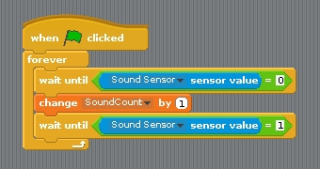
See the short pulses
The changes of the sound sensor are sometimes difficult to see just from the displayed sensor value
This code can be used to see that the sensor is actually working. You must create a variable SoundCount (or choose a different name) to hold the count.
‹nr.›

Slide 112
Strongly link the config file to the Arduino
111

Slide 113
The ident functionality
You created a board, but maybe you have omitted some resistors and therefore damage would occur if it were used with the wrong config file.
That is what the ident functionality is for
  Configure an identity in the Arduino
  Specify the identity in the config file
112

Slide 114
Programming the ident in the Arduino
Have the Arduino connected
Start the Arduino IDE
Go to monitor mode
Set the speed to 115200
Set the line end to newline
You can now type commands in the window.
Type:
  cident:PiAndMore10
  cident? (you should get the string back)
Put in the config tool the value PiAndMore10 in the field Parameter ident.pattern
113

Slide 115
Testing ident functionality
Start scratchClient and see that it works
Now change the value of the ident in the config file.
  Hardly matters what
Start scratchClient again and see that it will be rejected
114

Slide 116
More about ident
The ident can in the config file be specified as a regular expression. E.g.:
  A dot (.) matches any character
  A star (*) repeats the previous character (0 or more times)
  If you want to know more about regular expressions, see e.g.
  http://www.rexegg.com/regex-quickstart.html
So you could specify
  PiAndMore.* and it would work when PiAndMore9, PiAndMore10 or PiAndMore100 is programmed in the ident of the Arduino
Ident is also needed to identify a specific Arduino if multiple will be connected concurrently (see next slides).
115

Slide 117
Controlling multiple Arduinos
116

Slide 118
Control multiple Arduinos
Running out of pins on one Arduino? Connect more of them!
The /dev/ttyUSBnn port in the config file will define which part of the configuration is used for which Arduino.
Using the ident functionality (see previous topic) can be used to check that the correct Arduino was connected to the intended port.
  You can get the Arduinos on the correct ports by connecting them always in the same sequence.
117

Slide 119
Creating a config file for multiple Arduinos
First create two separate config files for each Arduino and test them out.
  The config tool can only work on a single adapter at a time.
Now create a new .xml file, and
  Copy in the first file completely
  Take the adapter section (most of the file) of the second file and paste this after the first adapter
  Adapt the USB port in one of the files (make the board that you connect last /dev/ttyUSB1.
118

Slide 120
Trying it out – merge and config
Take the Weekendschool board with the Duck
Test it out with the config file and the Scratch program
Merge the two files in the way described.
  Make the Weekendschool board /dev/ttyUSB1.
Disconnect both boards.
Restart scratchClient with the merged file.
Connect the workshop board first. It will become /dev/ttyUSB0.
Connect the Weekendschool board second. It will become /dev/ttyUSB1.
119

Slide 121
Trying it out – Control from Scratch
In the Scratch program of the workshop, define these variables
  Tiltservo
  Panservo
Try giving them values between 0 and 100 with the slider on the variable.
Does the duck tilt and pan?
120

Slide 122
Making the /dev/ttyUSBnn not matter anymore
In the way described before, the Arduinos must be connected in a specific sequence
You can alternatively use a program that will
  Look at the connected boards (using the ident string)
  Give a selection option to start with config files for which all the boards are present.
121

Slide 123
Explaining the startup tool
122

Slide 124
Power on self test (POST)
123

Slide 125
Power on self test (POST)
See the Weekendschool board with the duck.
When setting up the lesson, one wants to be able to quickly see whether the board works correctly.
Also, when the boards have to be packed, the duck should bow deep to make sure it fits in the box.
  Moving servos by hand is not preferred.
The scratchClient Arduino sketch has a place where you can insert your own code to realise this functionality.
124

Slide 126
How to do the POST?
You will need to address the pin numbers directly. You cannot make use of the config file of scratchClient.
See the Arduino sketch of the Weekendschool board.
  Between the xxxx and yyyy markers
Now try on the PiAndMore board to lite 3-color LED
  0.5 seconds Red
  0.5 seconds Green
  0.5 seconds Blue
  0.5 seconds White
Load the sketch in the board and look whether it works.
125

Slide 127
Controlling a relay
126

Slide 128
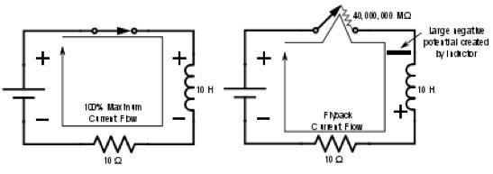
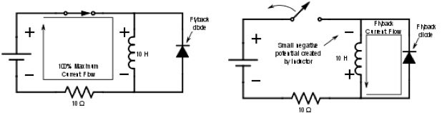
Controlling a relay
Controlling a relay like controlling a LED? NOT a good idea!
A relay has a coil that stores energy when powered.
  When breaking the current flow, the voltage over the relay coil can get so high that it destroys the Arduino – and more.
At least a flyback diode should be used.
127

Slide 129
Other issues – and the solution
Often the current of the coil will be too high to drive directly from the Arduino
  So a transistor will be needed.
Solution
  Use a relay module with an opto coupler
  Cost is generally not an issue. The relay module we use here is < € 1.
  We only have a few relays today, so you will need to share.
128

Slide 130
Connect the relay module to pin A2
Carefully follow the wires to connect correctly!
Don’t forget: power off and USB cable out before making changes!
129

Slide 131
Use a servo to press buttons on appliances
130

Slide 132
Safely controlling 220 Volt appliances
You can in principle use a relay to control 220 Volt appliances.
However, this is not something you want to do in a classroom situation
Alternative: use a remote control and use servos to press the buttons.
See also the next slide.
131

Slide 133
Controlling a camera
Use a servo to press the button of the camera
Cannot do in the workshop
See the example setup in the workshop
132

Slide 134
What else can scratchClient do?
133

Slide 135
Can scratchClient do more? Yes!
It can also let you configure and use the GPIO pins on the Raspberry Pi itself.
  However be aware:
    There is no analog input on Raspberry Pi.
    The pins are NOT 5 Volt tolerant (max 3.3 Volt).
    The max current per pin on Raspberry Pi is lower than on Arduino.
    If you blow up an Arduino (clone), the cost is limited to a few euro.
      A Raspberry Pi is much more expensive.
scratchClient can also control Sonic Pi for high quality audio.
There are also Arduino sketches to control LED strips (Neopixel WS2812) and to control LEGO Power.
scratchClient can work with Scratch 2.0 (soon).
scratchClient can also run on Windows and then via Arduino control peripherals.
scratchClient can work with multiple Raspberry Pi configurations in a network.
134

Slide 136
Take your work home
135

Slide 137
Do you want to take your work home?
If you brought your own USB stick, then connect it and copy the PiAndMore folder on the desktop
The rest of the material you can download from www.github.com
Take the flyer with you to remember where to find the material on github.
136

Slide 138
Clean up / teardown
137

Slide 139
Unplug and pack up
Unplug the board from USB and power it off
Please remove all components and wires from the breadboard
Remove all wires from the Arduino board.
Leave the wires on the 3 color LED
Leave the wires on the buzzer
If something is broken, please
  Throw it away or hand it in (if it is unclear)
  Put a note in the box that it is missing
  Do not put anything that is broken back in the box
Put everything in the box. The board goes on top
Shutdown the Arduino
Let us know what you thought about this workshop, now orally or later by email
  hans.piam@hanselma.nl
  heppg@web.de
138

Slide 140
More information
All workshop material
  www.github.com and search for Weekendschool or for PiAndMore
scratchClient
  http://heppg.de/ikg/wordpress/?page_id=6
Scratch
  https://scratch.mit.edu/
Scratch on Raspberry Pi
  https://www.raspberrypi.org/forums/viewforum.php?f=77
Raspberry Pi
  https://www.raspberrypi.org/
Arduino
  https://www.arduino.cc/
139

Slide 141
End of the Advanced Workshop
140

Slide 142
Appendix
141

Slide 143
Maximum current per pin
Max output current per pin = 20 mA
Total current for the board: 1 A
Note that also the potentiometer and the joystick take power
142

Slide 144
Cost of the setup (1 of 2)
This is a list of the cost of the setup of the external board.
Not included is the cost of the perspex board and the nuts and bolts, which are not an absolute minimum requirement
  And for which there are alternatives, e.g. use cardboard or an MDF board
All material comes from Aliexpress
  Very cheap
  Often no shipping costs to Europe
  Takes between 2 weeks and 2 months
    Or never arrives, but then money is promptly returned.
  When ordering below 22 euro, no import duties and handling costs
143

Slide 145
Cost of the setup (2 of 2)
144

Slide 146
The End
145

